Slide 1

E-commerce Data Visualization platform
Ting Wei
Xinchen Yang
Huang Jin
23May. 2023
Notes:
Wiem, że robiliście tak żeby fioletowy nie gryzł się z szarym, ale czerń i szarość przytła

Slide 2
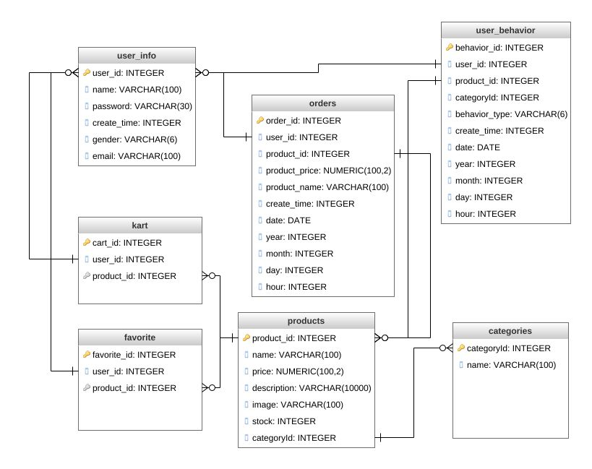

Databases of Visualization platform

Slide 3
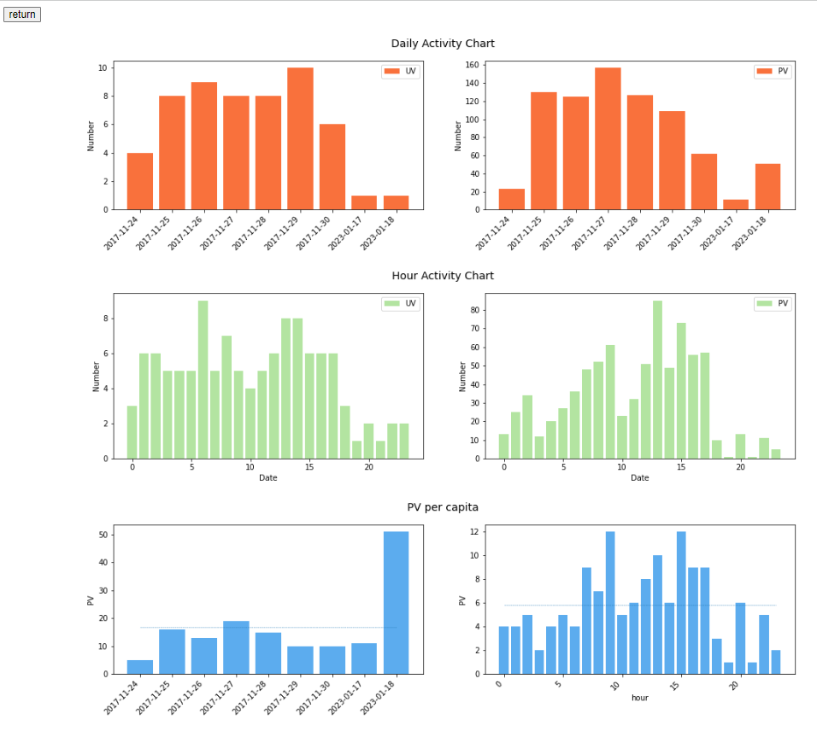
Consumer Activity Analysis
Bibliography
O projekcie
R

Slide 4
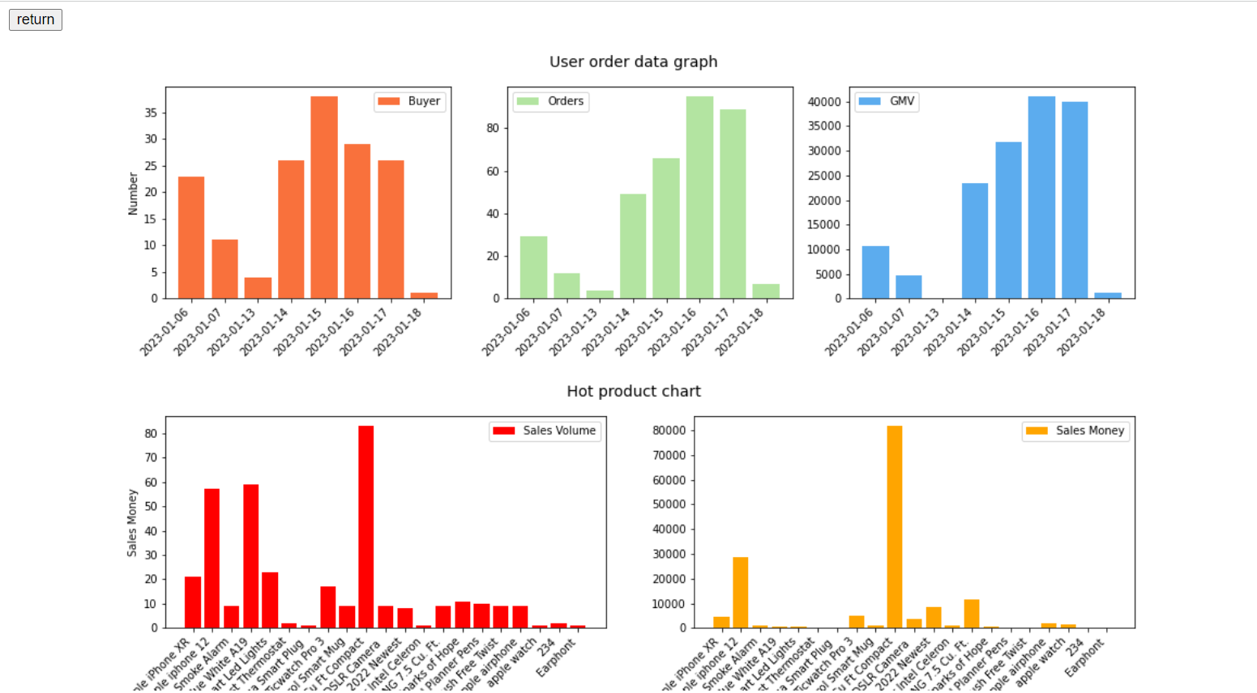
Consumer Order Analysis
Bibliography
O projekcie
R

Slide 5
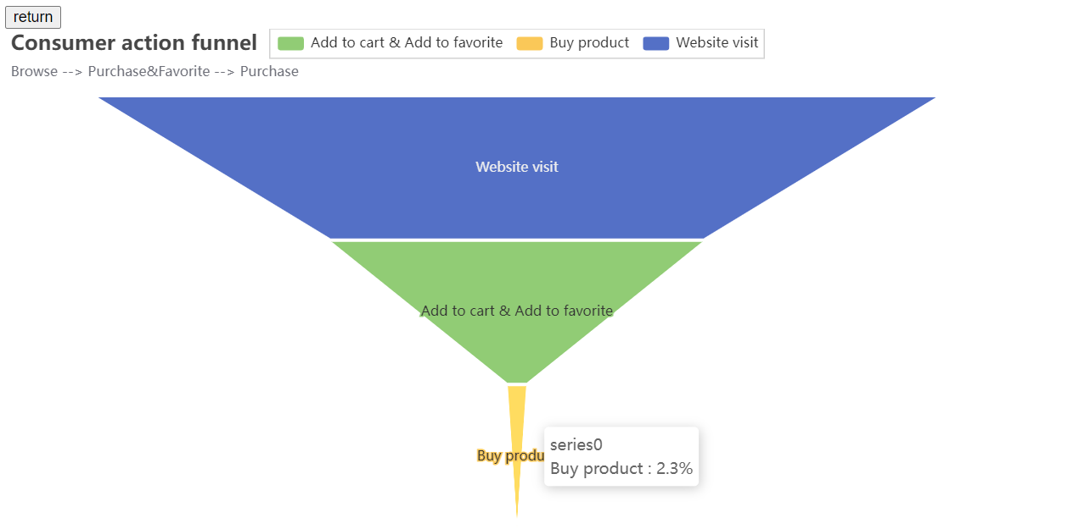
Conversion rate using funnel model 01
Bibliography
O projekcie
R
Browse → Add to Cart &Favorite → Purchase
Action conversion rate

Slide 6
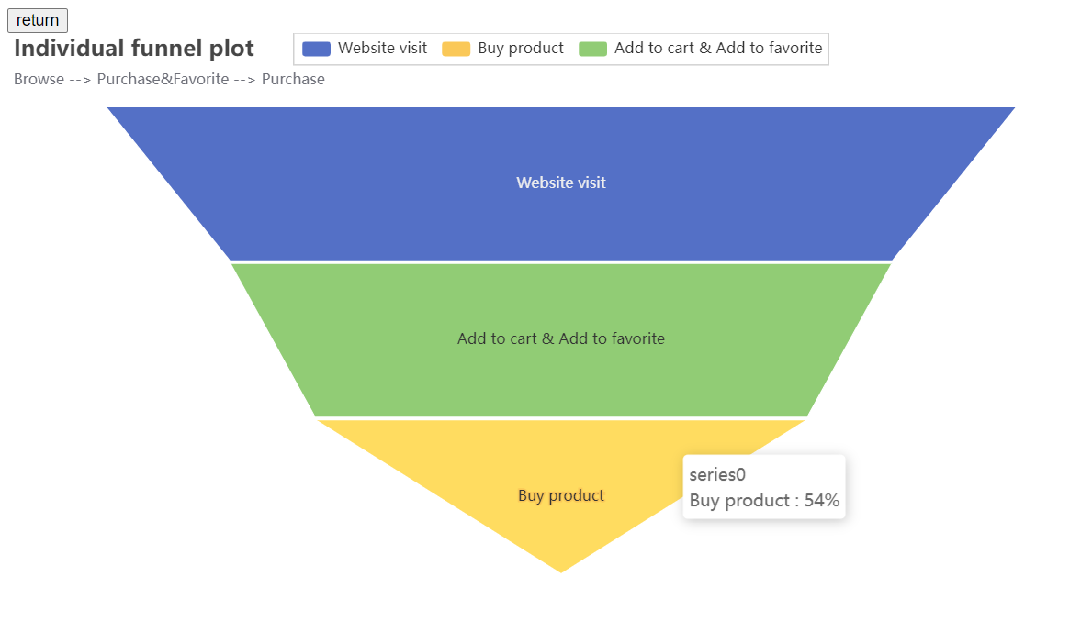
Conversion rate using funnel model 02
Bibliography
O projekcie
R
Browse → Add to Cart &Favorite → Purchase
Individual conversion rate

Slide 7
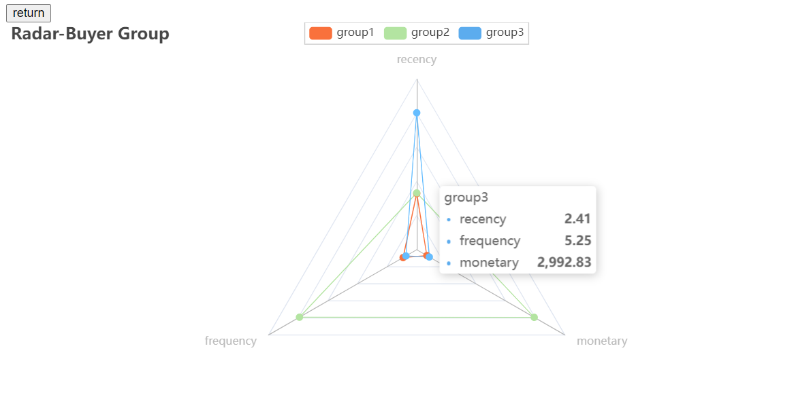
Consumer Segmentation using K-Means and RFM
Bibliography
O projekcie
R
Recency. How recent was the customer's last purchase?
Frequency. How often did this customer make a purchase in a given period?
Monetary. How much money did the customer spend in a given period?

Slide 8
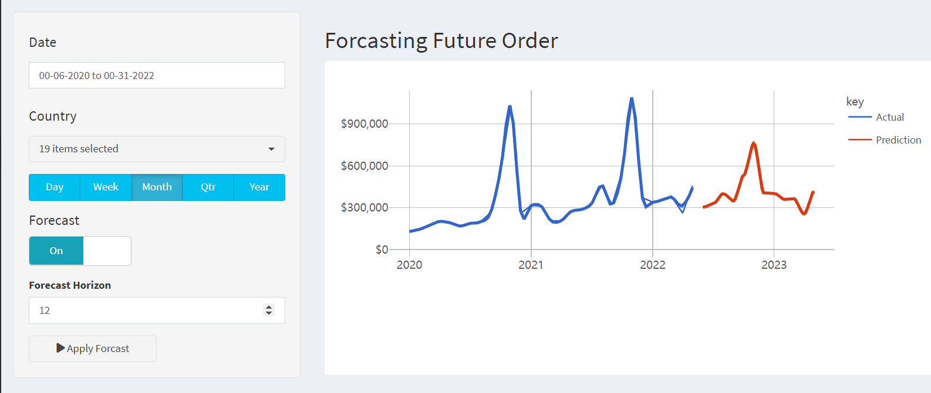
Future Order Forecast
Bibliography
O projekcie
R

Slide 9
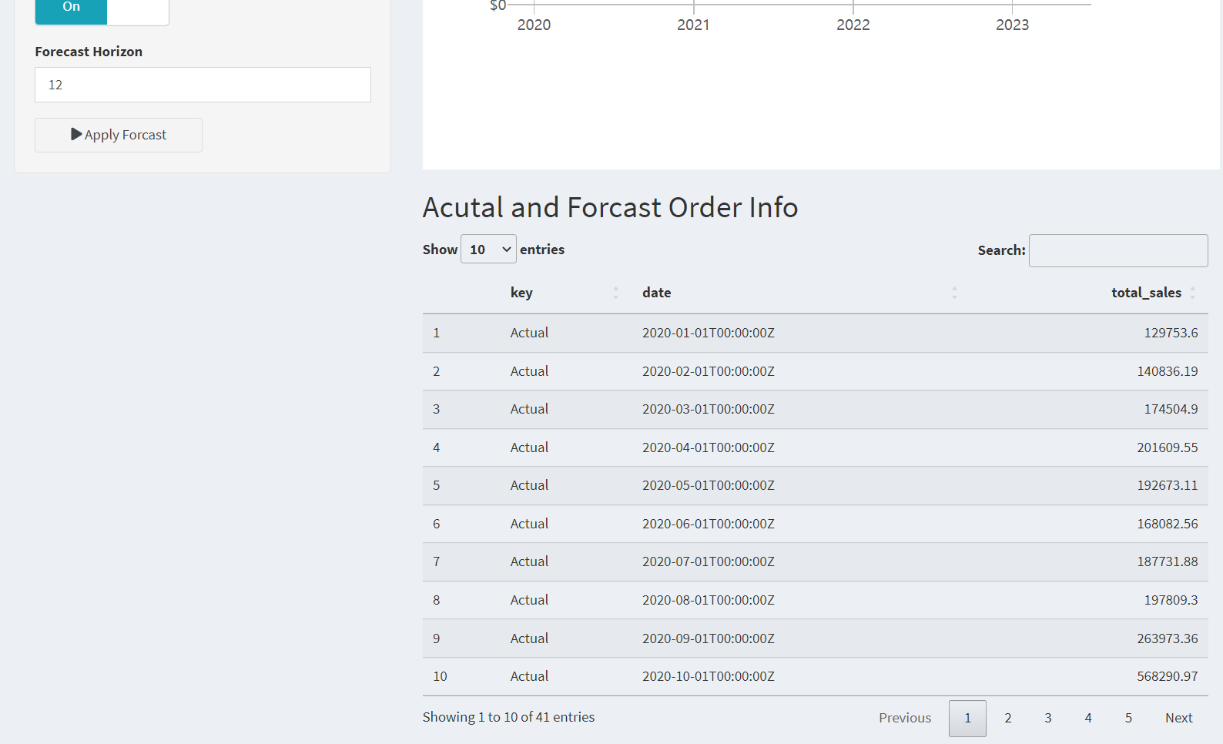
Future Order Forecast
Bibliography
O projekcie
R

Slide 10
Future Order Forecast
Bibliography
O projekcie
R

Slide 11
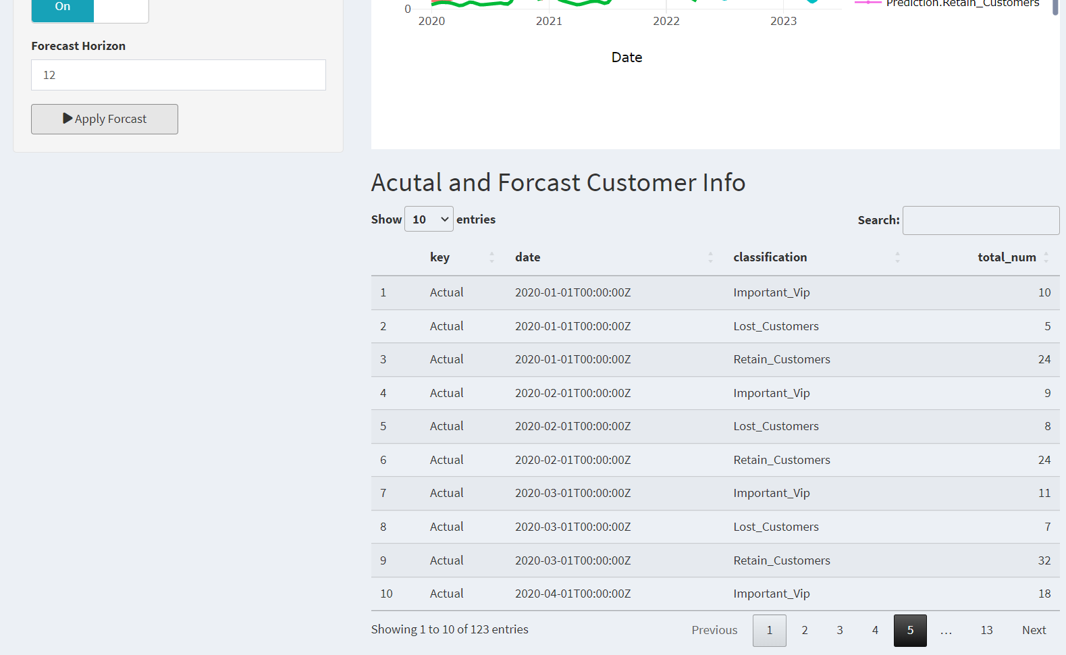
Consumer Forecast
Bibliography
O projekcie
R

